Slide 1


Welcome you all
Network Layer
D.Sakthivel
Assistant Professor & Trainer,
KG Micro College
KGiSL Campus, Coimbatore – 641 035.

Slide 2
Network Layer

Slide 3
Network Layer
Types of Address used for System Identity
IP Address
Example : IPV4 - 192.168.253.177
IPV6 - 2405:201:e016:202a:a582:e4a2:964e:36dd
MAC Address
Example : 40-1C-83-BD-71-36

Slide 4
IP Address
Possible IPs : 2³² = 4 x 10 ⁶
11000000 | 10101000 | 11111101 | 10110001
192 | 168 | 253 | 177
8 bits (0-255) | 8 bits (0-255) | 8 bits (0-255) | 8 bits (0-255)
32 bit Register
IPV 4
2405 | 201 | e016 | 202a |  | a582 | e4a2 | 964e | 36dd
16 bits | 16 bits | 16 bits | 16 bits | 16 bits |  | 16 bits | 16 bits | 16 bits
128 bit Register
IPV 6
Possible IPs : 2³² = 4 x 10 ⁶

Slide 5
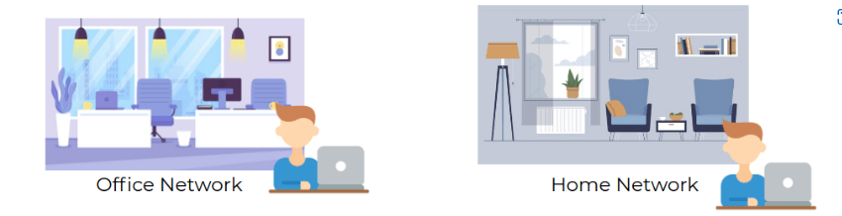
MAC Address Vs IP Address
MAC Address IP Address
MAC Address IP Address
40-1C-83-BD-71-C6 192.168.29.40
40-1C-83-BD-71-C6 192.168.29.40

Slide 6
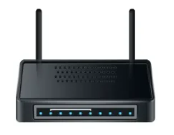
Router
Forward data between independent networks.
Store route information for different networks all over the world.
Network Layer device

Slide 7
Wireless Router
Wireless Routers are combination of
Router
Switch
Wireless Access Point

Slide 8
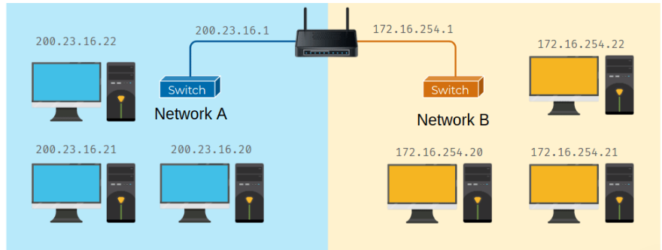
Router

Slide 9
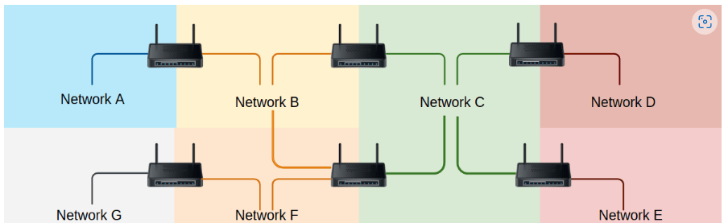
Network of networs

Slide 10
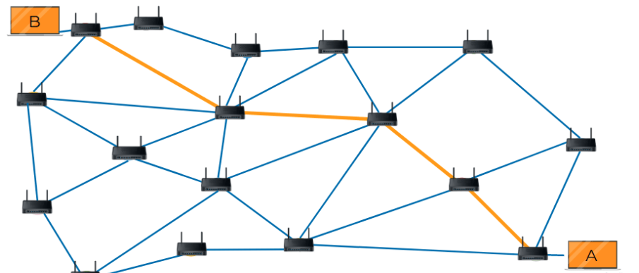
Router

Slide 11
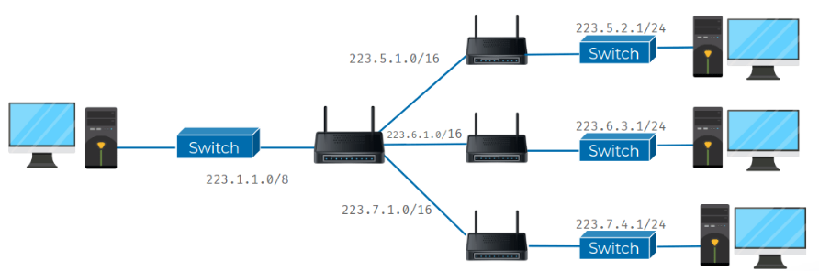
SUBNETTING
Network Efficiency
Security
Easier Management

Slide 12
Forwarding
a router receives a packet of data on one of its interfaces
the router examines the destination IP of this packet.
the router then looks up the destination network of this IP in its routing table.
the router forwards that out though the interface that's closest to the remote network. As determined by additional info within the routing table.
These steps are repeated as often as needed until the traffic reaches its destination.

Slide 13
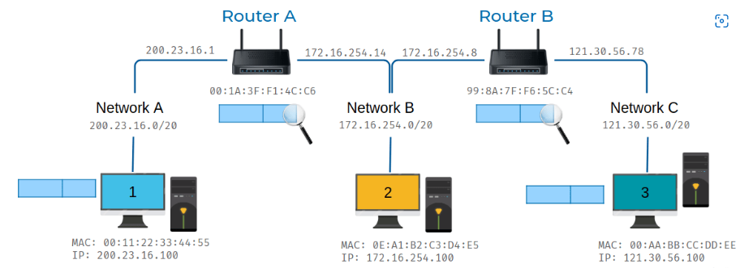
FORWARDING - Example

Slide 14
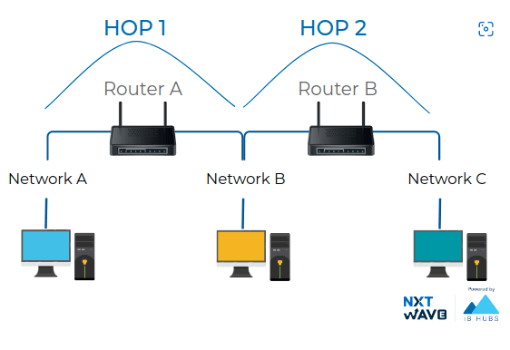
HOP

Slide 15
Time to Live

Slide 16



Thank You

